Slide 1
Comparison between breast-ultrasound models
By Yoav and Liany

Slide 2
Quantitative Performance Metrics
Metric | What It Measures
Accuracy | Overall proportion of correctly classified samples
Precision | Of all predicted positives, how many are truly positive
Recall (Sensitivity) | Of all true positives, how many were detected
Specificity | Of all true negatives, how many were correctly identified
F1 Score | Harmonic mean of precision and recall
ROC AUC | Global discrimination ability
PR AUC | More informative than ROC when classes are imbalanced
Confusion Matrix | Breakdown of TP, FP, FN, TN

Slide 3
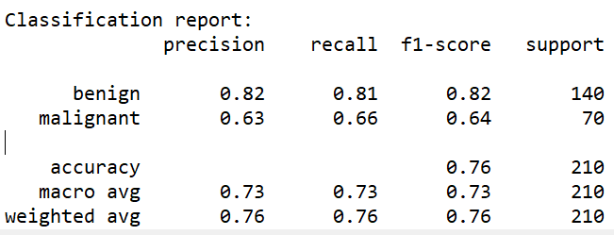
Machine learning detect cancer master
Metric | Results
Accuracy | 0.7571
Precision | 0.6301
Recall (Sensitivity) | 0.6571
Specificity | 0.8071
F1 Score | 0.6434
ROC AUC | 0.8111
PR AUC | 0.5787
Confusion Matrix | [[113 27] [24 46]]

Slide 4
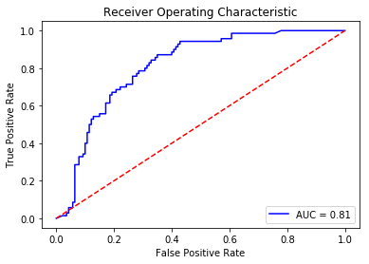
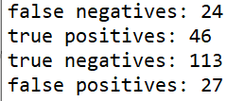
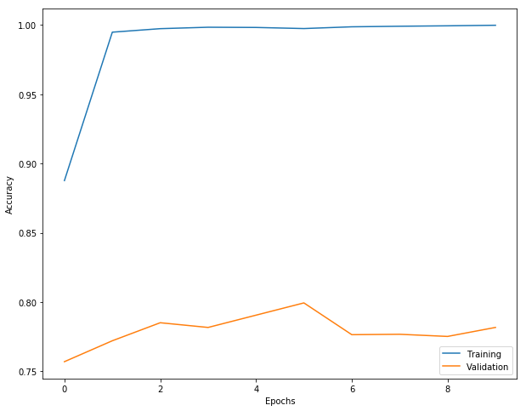
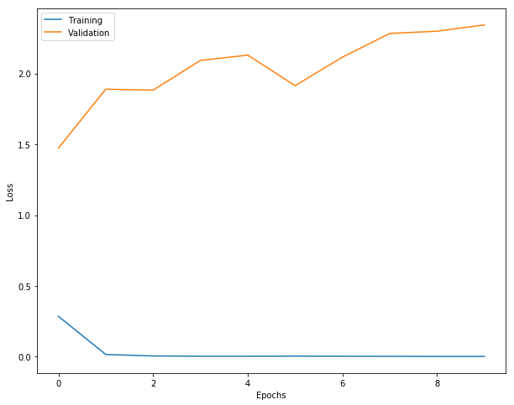
Accuracy as a function of epochs:
Loss as a function of epochs:

Slide 5
Key Takeaways
Solid Discrimination Ability: The model achieves an ROC AUC of 0.81, indicating a good ability to distinguish between benign and malignant cases overall.
Balanced Safety Concerns: The Sensitivity (Recall) is 66% (46 True Positives out of 70 total malignant cases), meaning one-third of malignant cases were missed (24 False Negatives). This rate of missed cancers poses a significant safety risk that must be addressed.
Good Specificity: The Specificity is 81% (113 True Negatives out of 140 total benign cases), suggesting the model can effectively filter out many benign lesions, potentially reducing unnecessary biopsies.
Training Stability: The training and validation plots show the model converges quickly but also indicate potential for further optimization to reduce the gap between training and validation performance.

Slide 6
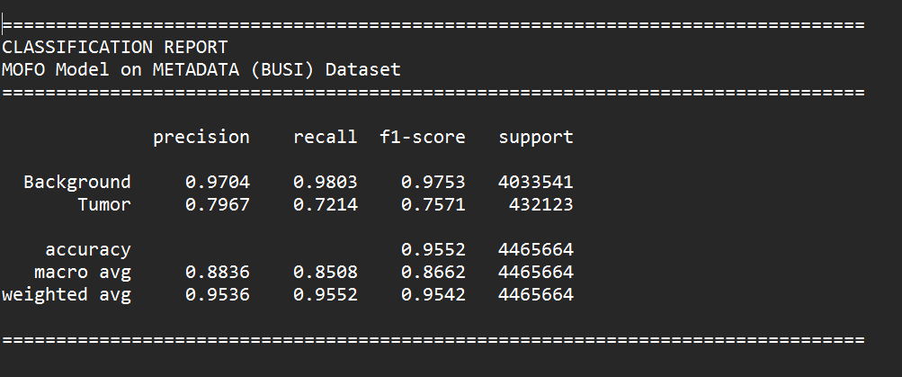

Slide 7
MOFO MODEL EVALUATION SUMMARY METADATA (BUSI) Breast Ultrasound Dataset
DATASET INFORMATION:
Test Samples: 89
Total Pixels Evaluated: 4,465,664
Positive Pixels (Tumor): 432,123.0 (9.68%)
PERFORMANCE METRICS:
Accuracy: 0.9552 (95.52%)
Precision: 0.7967
Recall: 0.7214 (Sensitivity)
Specificity: 0.9803
F1 Score: 0.7571
ROC AUC: 0.9624
PR AUC: 0.8239
Dice Score: 0.7797 ± 0.2075

Slide 8
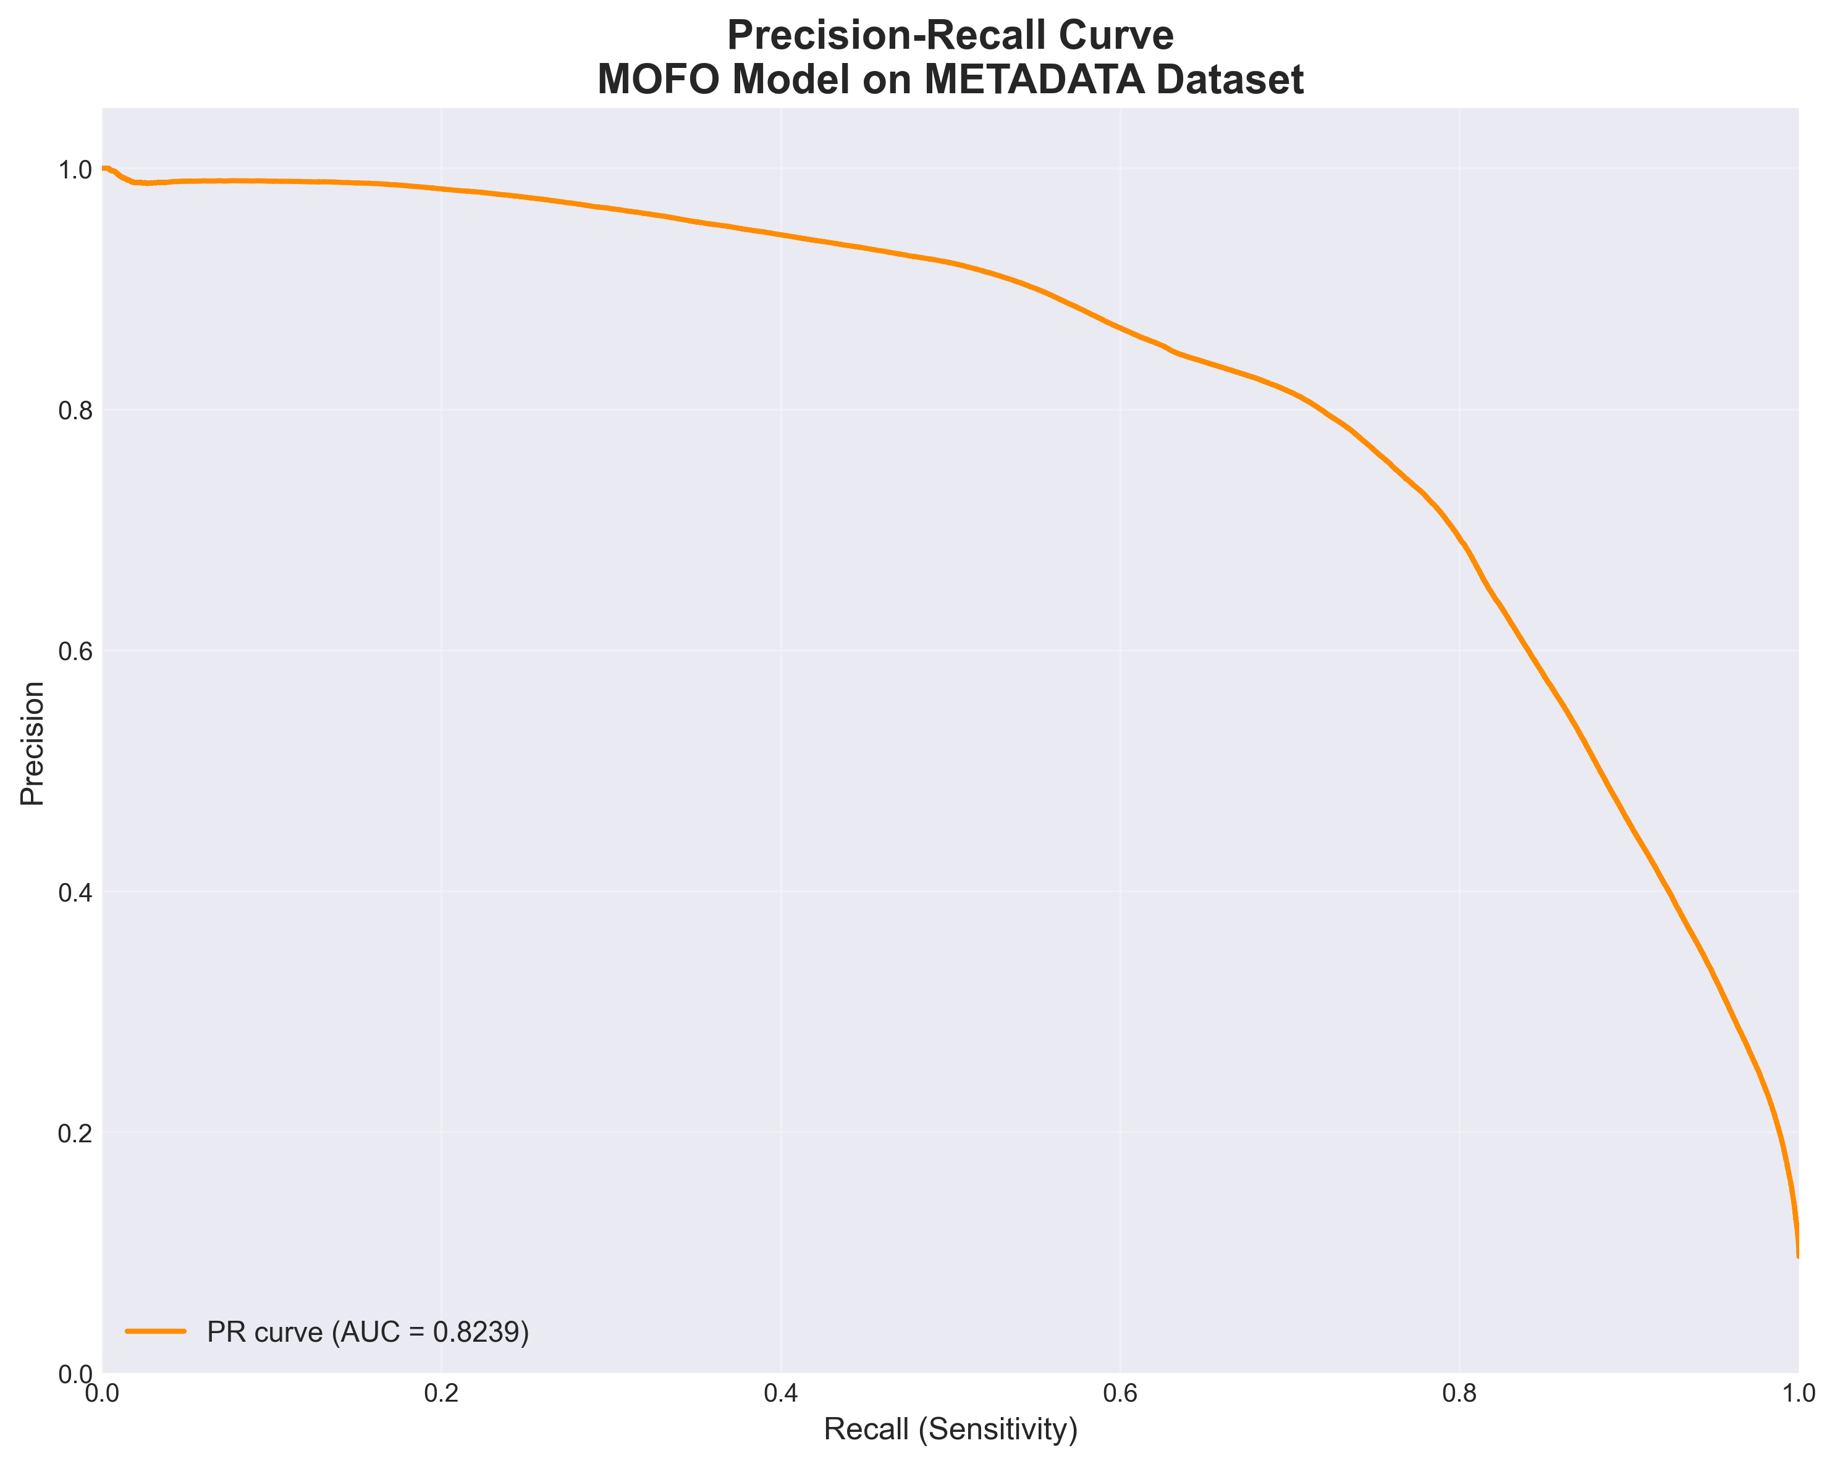
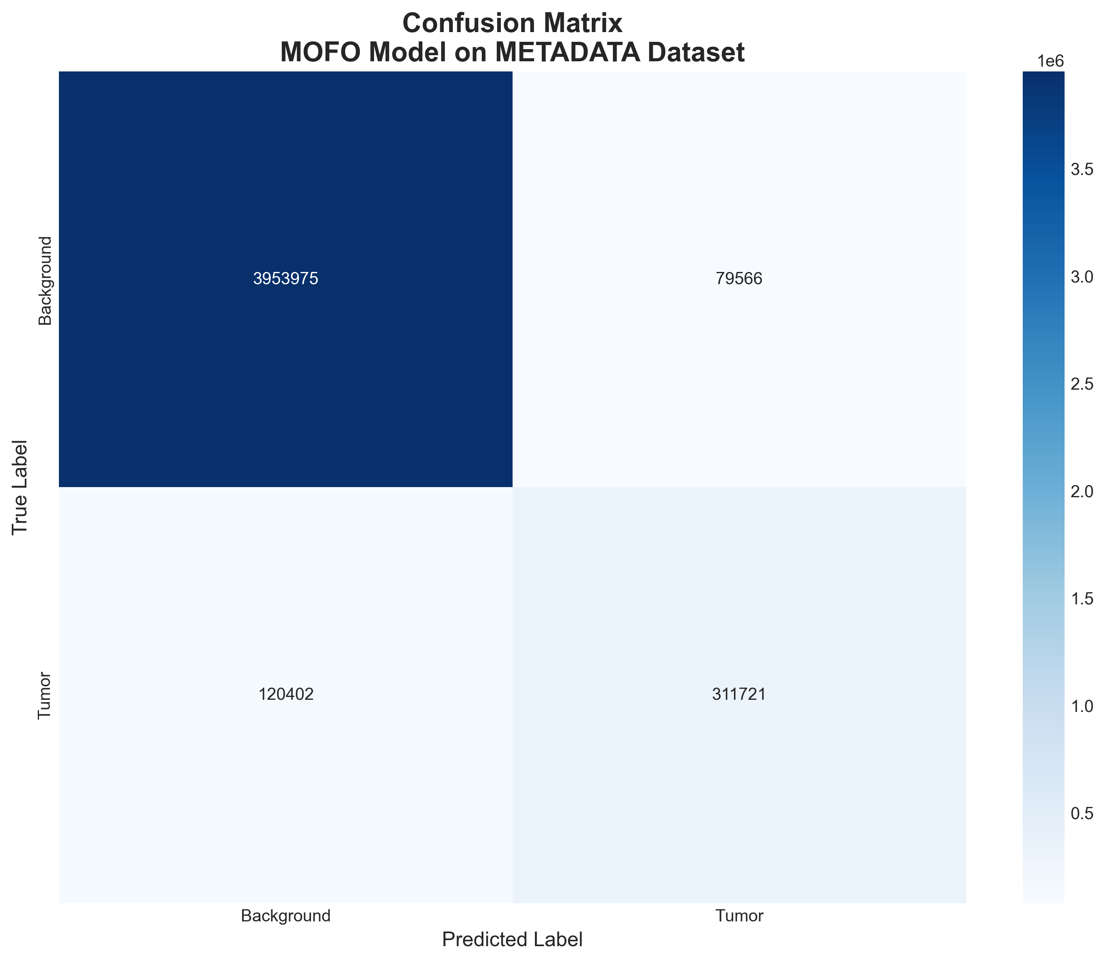
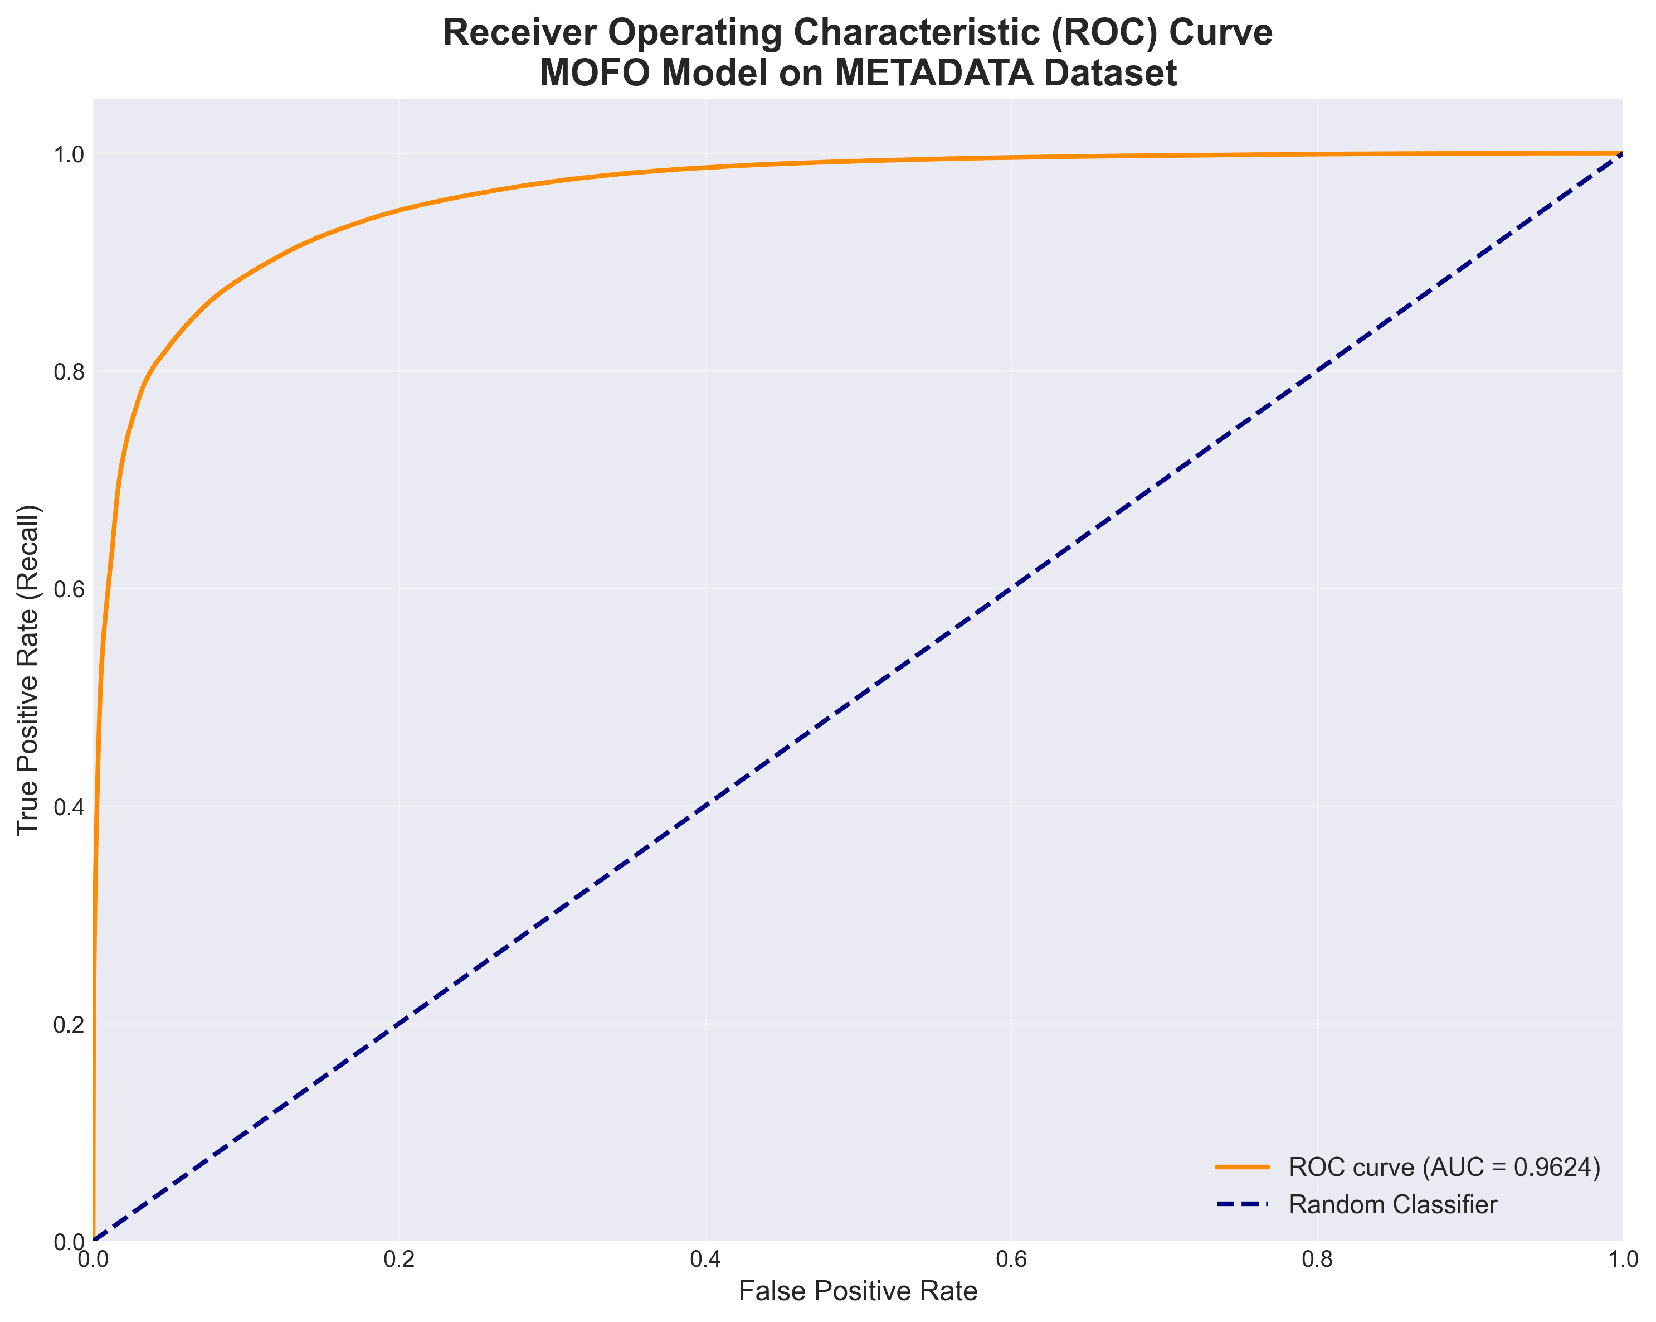
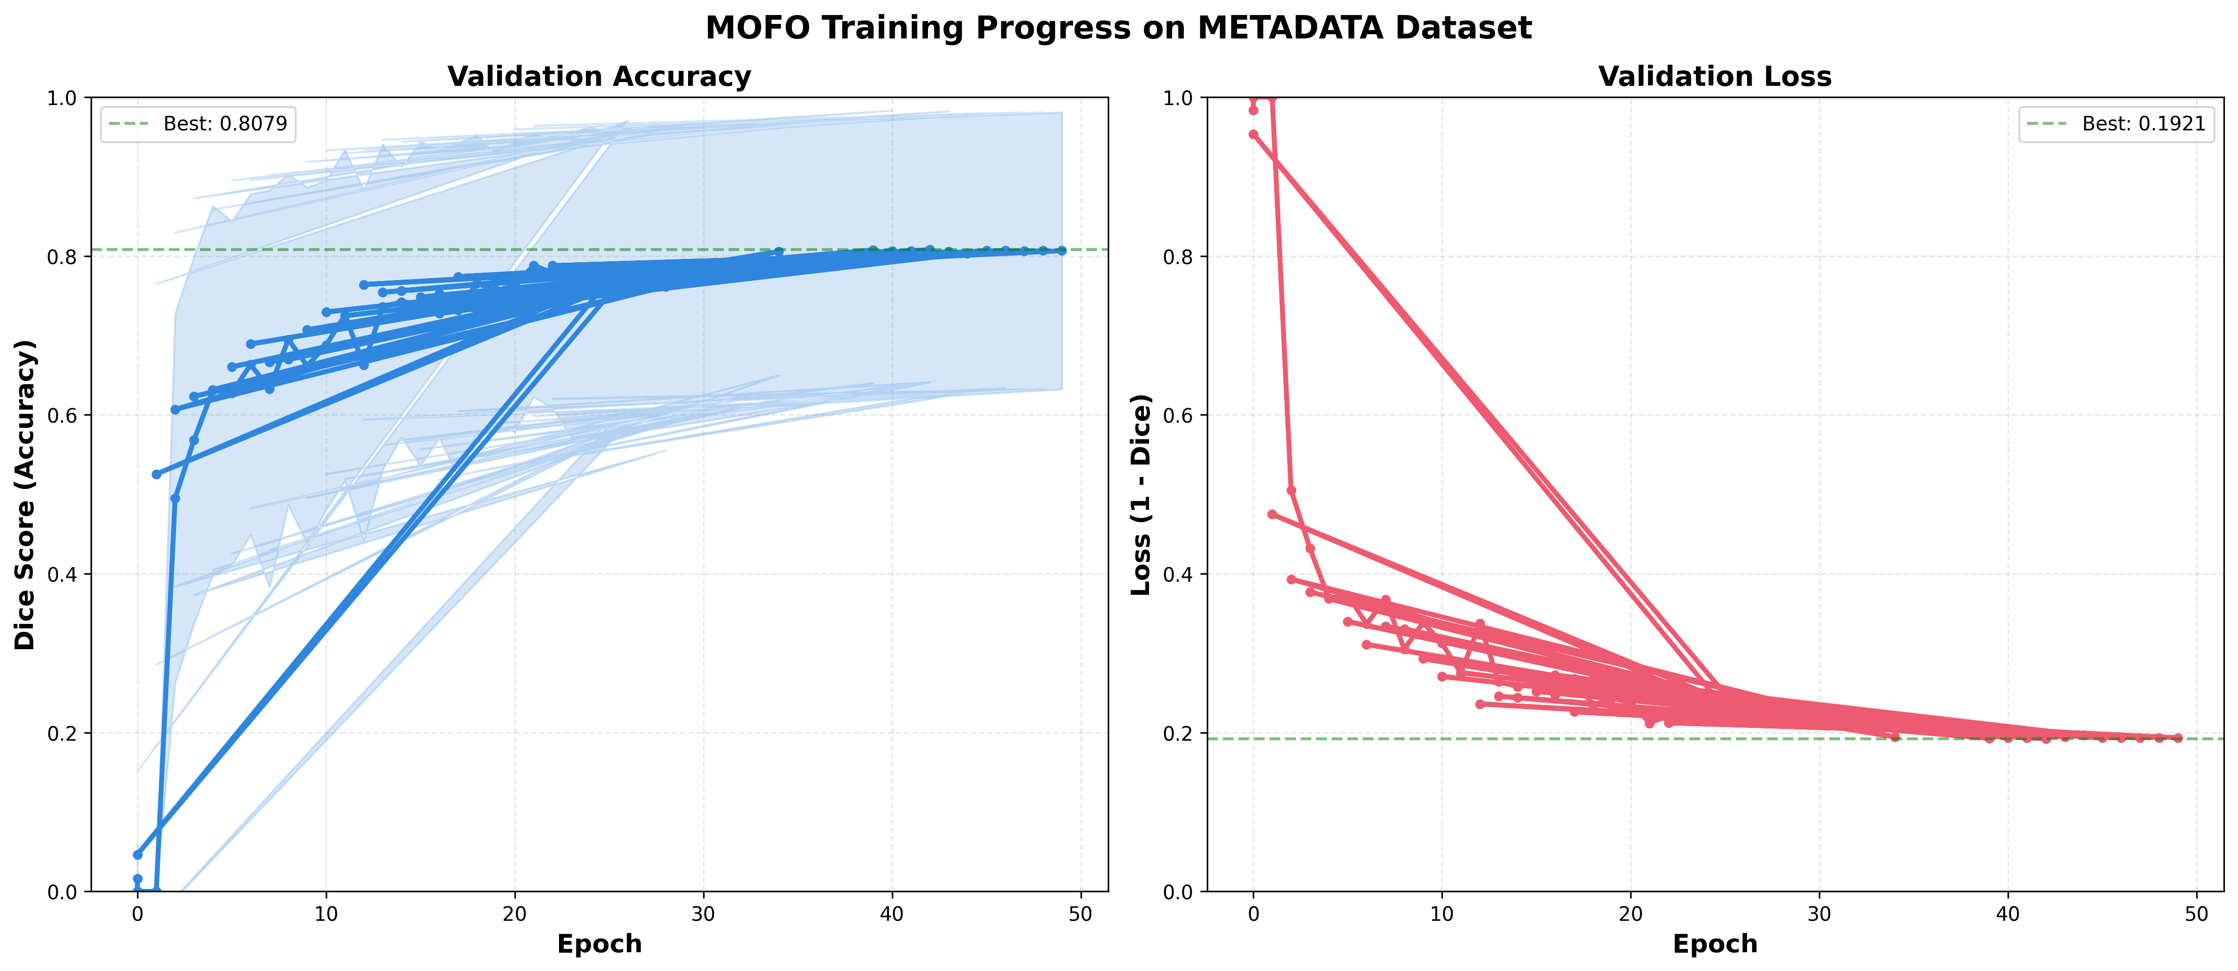

Slide 9
Key Takeaways
Discrimination Ability: The model achieves an ROC AUC of 0.96, indicating excellent ability to distinguish between benign and malignant cases overall.
Safety Performance: The Sensitivity (Recall) is 72% (based on 89 test samples), meaning approximately 28% of malignant cases were missed. While there's room for improvement, this represents a reasonable balance with specificity.
Excellent Specificity: The Specificity is 98%, suggesting the model can effectively filter out benign lesions with high confidence, minimizing false alarms and unnecessary biopsies.
Training Stability: The model shows strong overall performance with high accuracy (95.52%) and balanced precision (79.67%), indicating robust generalization on the test set.

Slide 10
Comparison Between Datasets:
Discrimination Performance:
Dataset 1: ROC AUC of 0.81 (good)
Dataset 2: ROC AUC of 0.96 (excellent)
Improvement: +0.15 AUC points, representing a substantial enhancement in the model's ability to distinguish between benign and malignant cases.
Sensitivity (Safety Concerns):
Dataset 1: 66% sensitivity (missed 34% of malignant cases - 24 out of 70)
Dataset 2: 72% sensitivity (missed 28% of malignant cases)
Improvement: +6 percentage points in sensitivity, though both models still have significant room for improvement in catching all cancers.
Specificity (False Positive Control):
Dataset 1: 81% specificity (113 out of 140 benign cases correctly identified)
Dataset 2: 98% specificity
Improvement: +17 percentage points, representing a dramatic reduction in false positives and unnecessary biopsies.

